Slide 1
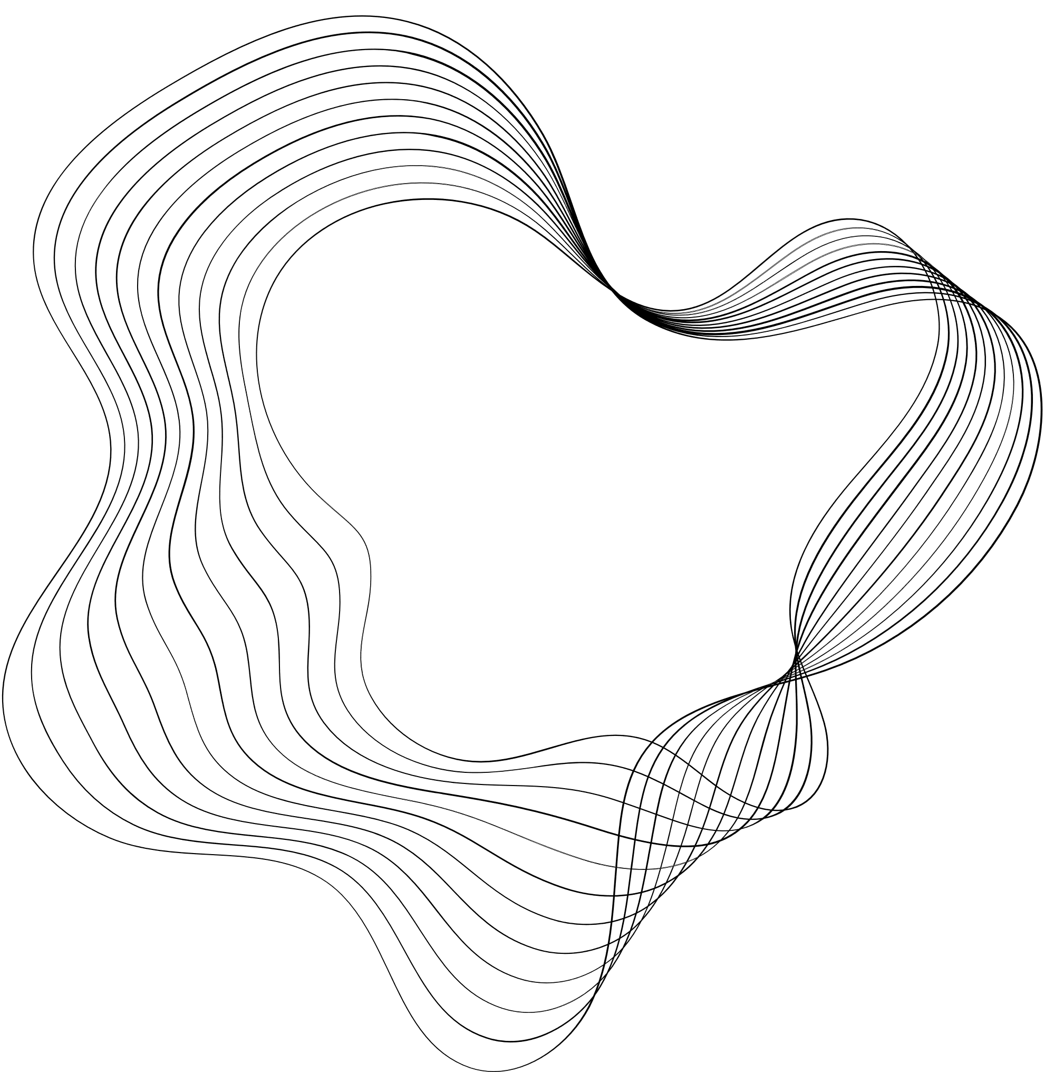


ME224 : Kinematics of Machinery
MECANUM WHEELS
ROBOTICS AND MOBILITY TECH
Kashvi Agrawal
(230103048)
Department of Mechanical Engineering
Indian Institute of Technology Guwahati
Notes:
Hello everyone, thank you for joining us today. I’m Mishika Agarwal, and alongside Kashvi Agrawal, we are excited to present our project on Mecanum Wheels and their kinematic analysis.

Slide 2
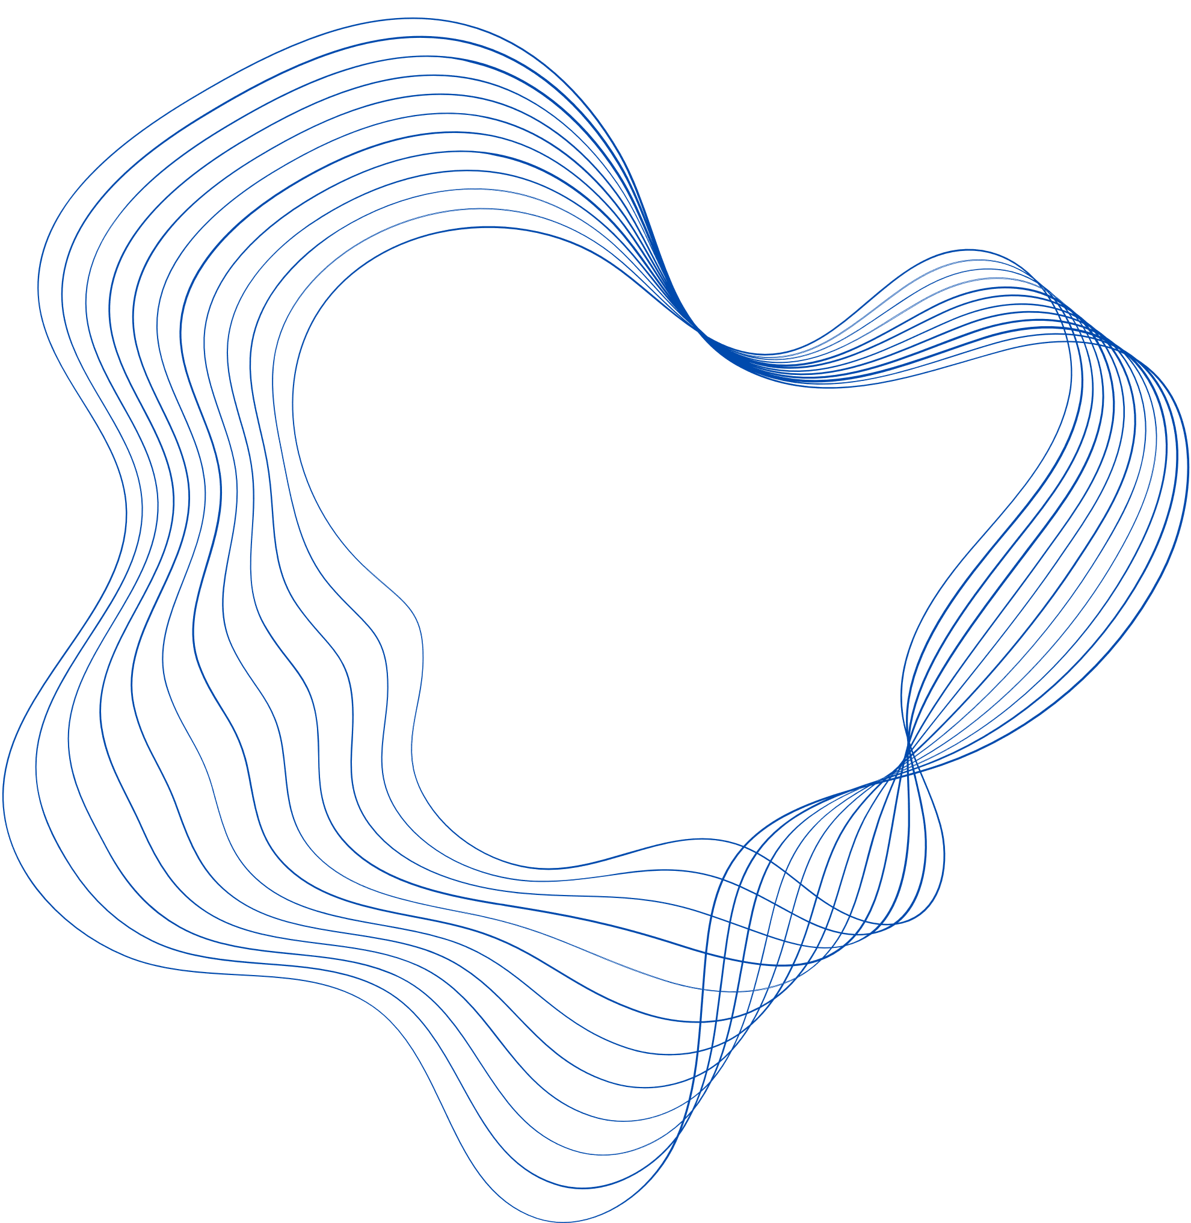
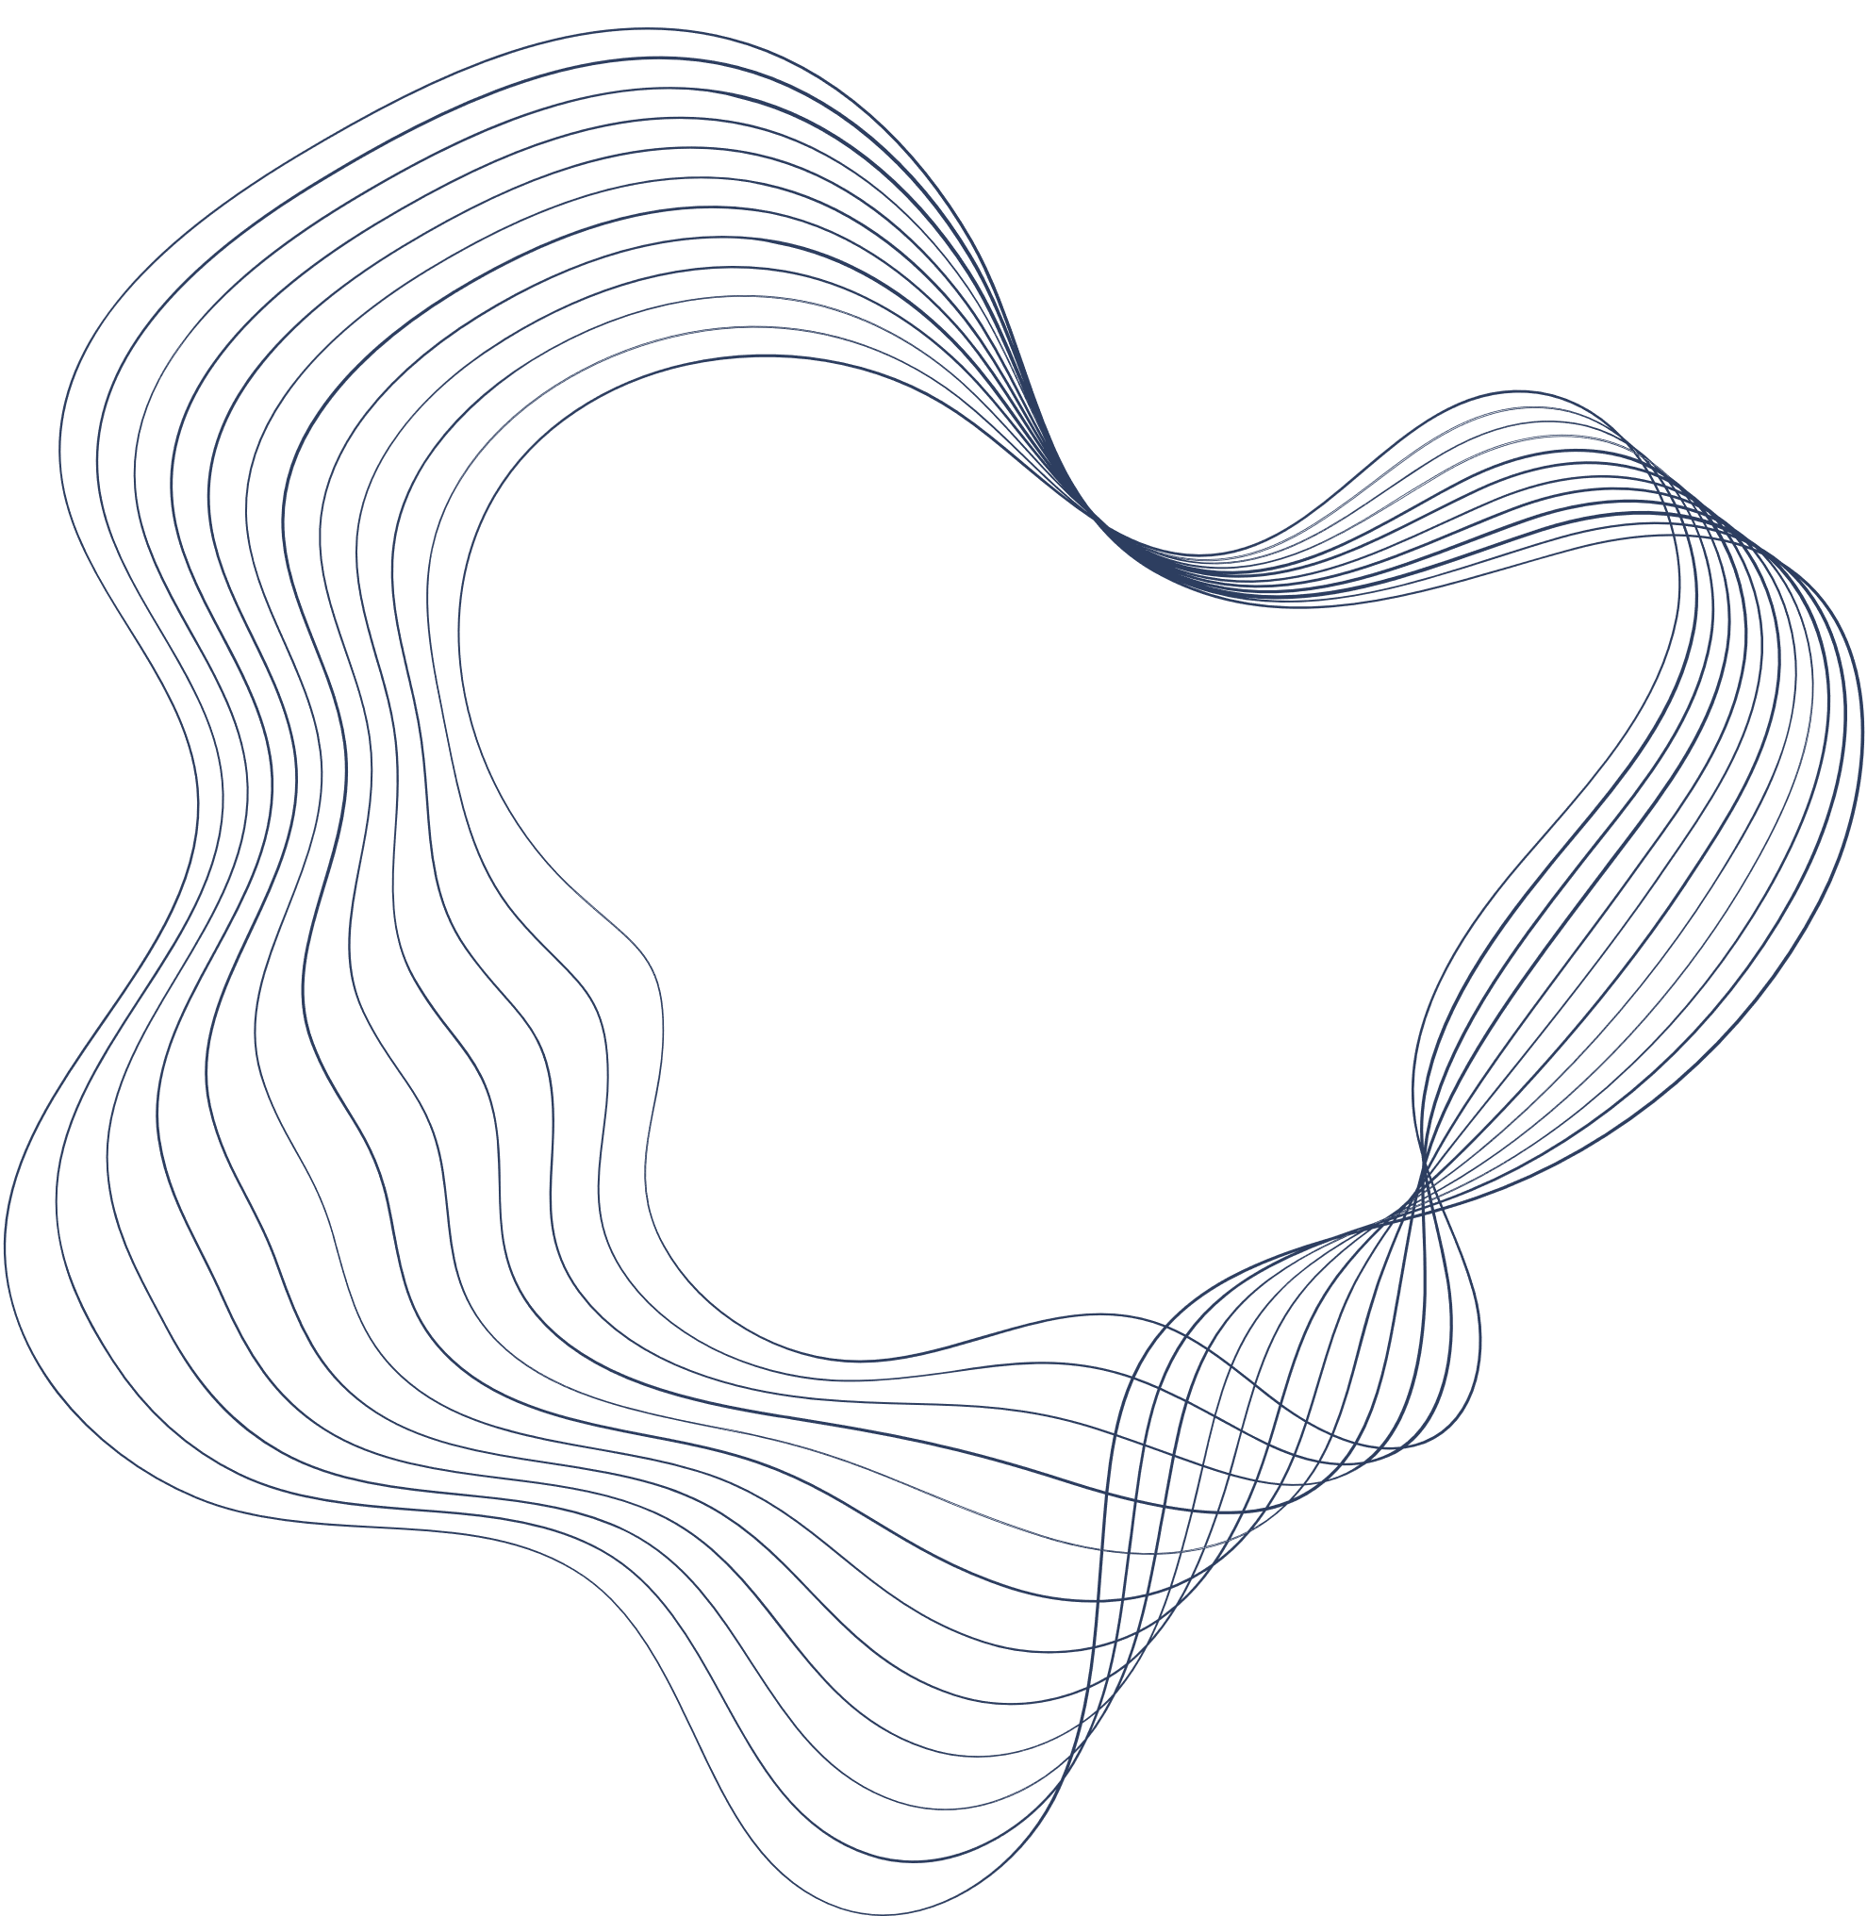
MOTIVATION & INTRODUCTION
From Sweden to Smart Robots:
Mecanum wheels are omnidirectional wheels that allow land-based vehicles to move in any direction — forward, sideways, diagonally, or even rotate in place.
Each wheel uses rollers set at a 45° angle, which redirect force diagonally when the wheel spins. By coordinating the rotation of four such wheels, a robot can achieve precise, holonomic motion in tight spaces.
This design has revolutionized maneuverability in robotics and mobility tech, including wheelchairs, where traditional rear- or front-wheel drives struggle with large turning radii. Mecanum wheels offer a compact, responsive alternative — ideal for confined environments like hospitals and homes.
🛞 Inventor Origins:
Also known as the Swedish wheel or Ilon wheel.
Invented by Bengt Erland Ilon (1923–2008) at Mecanum AB, Sweden.
Patented in the US on November 13, 1972, revolutionizing omni-motion for ground vehicles.
🛞Research & Engineering Applications:
Became a game-changer in robotics, assistive tech, and automated logistics.
Inspired by studies on railway wheel contact mechanics and pneumatic tire behavior:
Models like the Brush tire and Magic Formula laid the groundwork.
Notes:
Imagine a robot that can move forward, sideways, diagonally, or even rotate in place—without changing its orientation.
Traditional wheels struggle in tight spaces. That’s where Mecanum wheels, invented by Bengt Ilon in 1972, revolutionize omnidirectional mobility.
Our goal was to explore the kinematic principles that make this possible, model them in Fusion 360, and link theory with real-world applications.

Slide 3

OBJECTIVE
To design a Mecanum wheel system demonstrating omnidirectional mobility using
fundamental kinematic principles.
The project aims to:
Explore the kinematic principles behind Mecanum wheel movement
Apply concepts of kinematic pairs, joints, and mobility analysis to develop a functioning CAD model in Fusion 360.
Simulate the wheel's displacement, velocity, and motion behavior, linking theoretical principles with real-world applications.
Understand the real-world applications in fields requiring high maneuverability, like robotics, assistive mobility devices, and automated systems

Slide 4
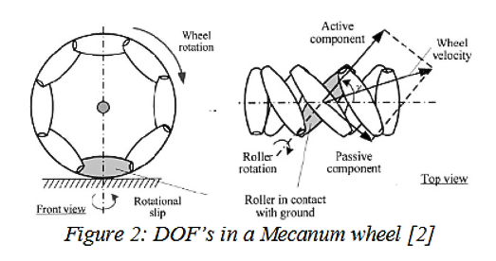
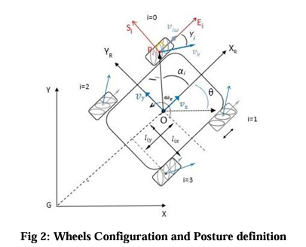
KINEMATIC ANALYSIS -DOF
Singular Mecanum Wheel
3 DOFs composed of wheel rotation, roller rotation and rotational slip about the vertical axis passing through the point of contact (Figure 2).
The active component is directed along the axis of the roller in contact with the ground, while the passive one is perpendicular to the roller axis.
Planar Mobile Robot
3 DOF: two for translation (along the X and Y axes) and one for rotation (about the Z-axis).
The system is kinematically over-constrained i.e. there are four DoF, out of which one is redundant.

Slide 5
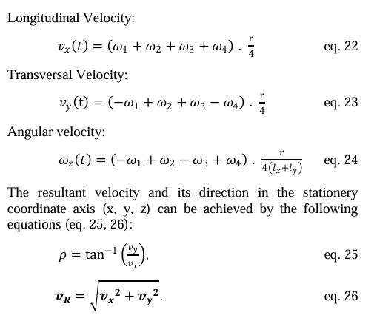
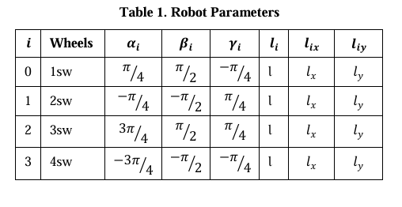
OMNIDIRECTIONAL SOLUTION
considering equations for the Forward and Inverse kinematics of the system
replacing the given parameters with Jacobians for the same
we obtain the velocity solutions
Notes:
To obtain the velocity solution for a four wheeled drive, we have substituted the parameters as shown here, in the Jacobian matrices. Then substituting these matrices in the equations for forward and inverse kinematics, we obtain the final expressions. As shown here.

Slide 6
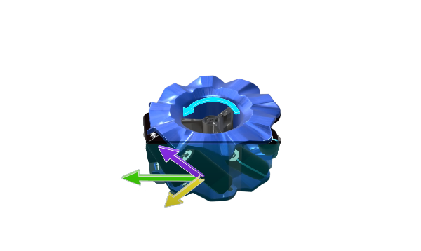
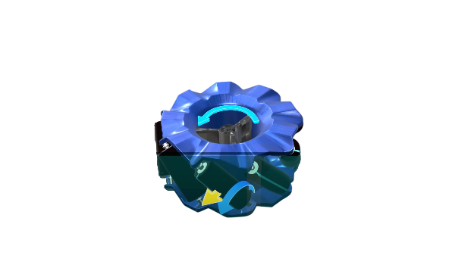
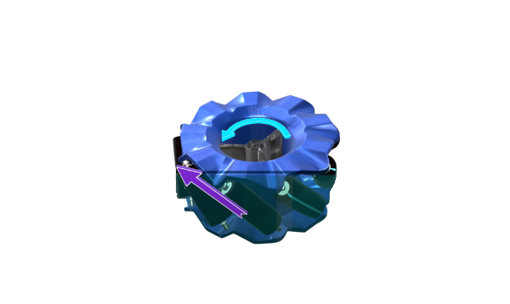
FORCE ANALYSIS
When the motor‑driven Mecanum wheel contacts the ground, friction arises at each roller’s contact point.
Decomposition of Frictional Force: This frictional force can be split into two components:
Tangential Component: along the roller’s circumference
Axial Component: along the roller’s axis
The roller is free to spin in the tangential direction, so the tangential component of the force will be very small.
In the axial direction, a significant force transfer occurs.
Despite spinning like a regular wheel, the mechanim wheel produces a driving force at an angle of 45 degrees due to the frictional forces.
Notes:
As shown, as soon as the electric motor-powered Mecanum wheel touches the ground, a frictional force is generated at the contact point. As we saw earlier, can you predict what will happen next? Let's split this frictional force into two components: one along the axis of the roller and the other tangential to it. Since the roller is free to spin in the tangential direction, the magnitude of the tangential component of the force will be very small. However, in the axial direction, there will be significant force transfer. In short, although the Mecanum wheel spins like a normal wheel, it produces a frictional or driving force at an angle of 45 degrees.

Slide 7
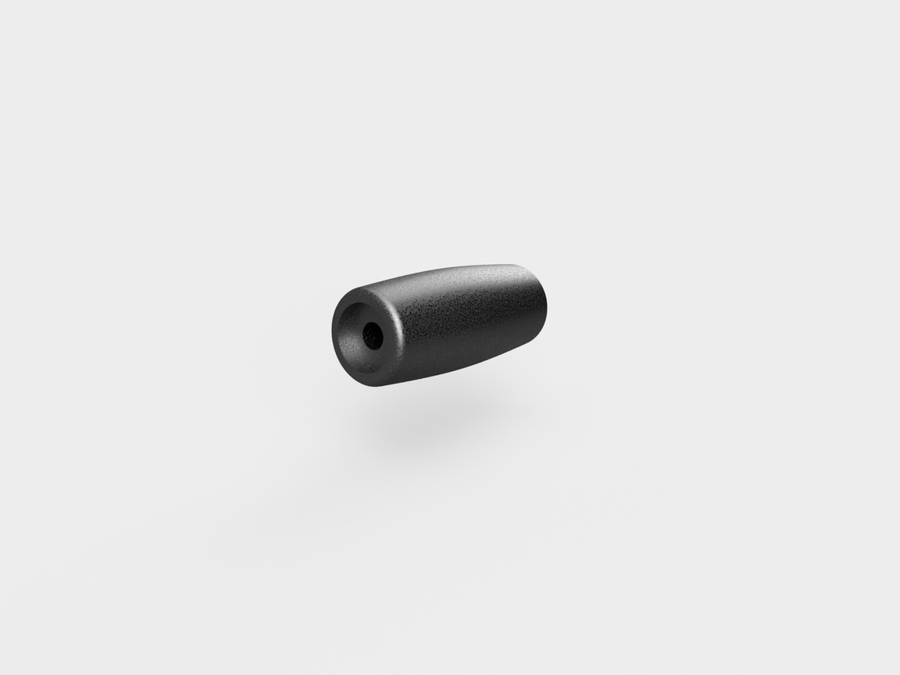
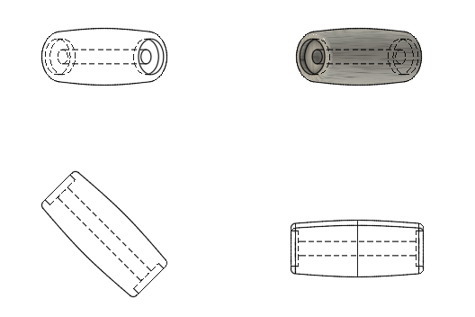
KINEMATIC SYNTHESIS
~designing the roller geometry
The roller of a Mecanum wheel is designed as a surface of revolution.
Generated by rotating a smooth hyperboloid about its own axis.
This surface enables continuous, controlled contact with the ground as the roller rotates.
Unlike flat or cylindrical rollers, this curved profile ensures a gradual entry and exit of contact during rotation, minimizing vibration and impact.
This geometrical choice allows a compact mechanical fit, enhances force transmission and supports higher loads in real-world applications.
Sectorwise
Comparison
Filtering
Companies
SWOT
Analysis
Company Performance
Insight From
Budget
*All designs and simulations were done using FUSION360.
Conclusion
Appendix
Notes:
Now let’s take a closer look at the rollers of the mecanum wheel. The problem with cylindrical rollers, was that they caused jerky movement of the drive. To solve this, the inventor, mr.ilon, chiselled off some portion of the cylinder, which yielded better results. In an parametrised solution, we use a hyperboloidic curve to generate the surface of rev. this ensures gradual contact upon ntry and exit, which unlike shark cylindrical rollers, minimises vibration and impact.

Slide 8



COMPUTER AIDED DESIGN (CAD)
*All designs and simulations were done using FUSION360.
Notes:
In this slide, I have shown, three separate views of the mecanum wheel, we designed on fusion360. the design process started off with the ideation phase, during which we studied and observed pre existing designs, to identify the key components. Upon consideration, we came up with the central hub, as shown in yellow, the rollers angled at 45 dgr to the axis, and the two aluminium frames which hold the assembly together. Preferably, the rollers should be rubber coated to provide traction. But on the flip side it can also cause more wear.

Slide 9
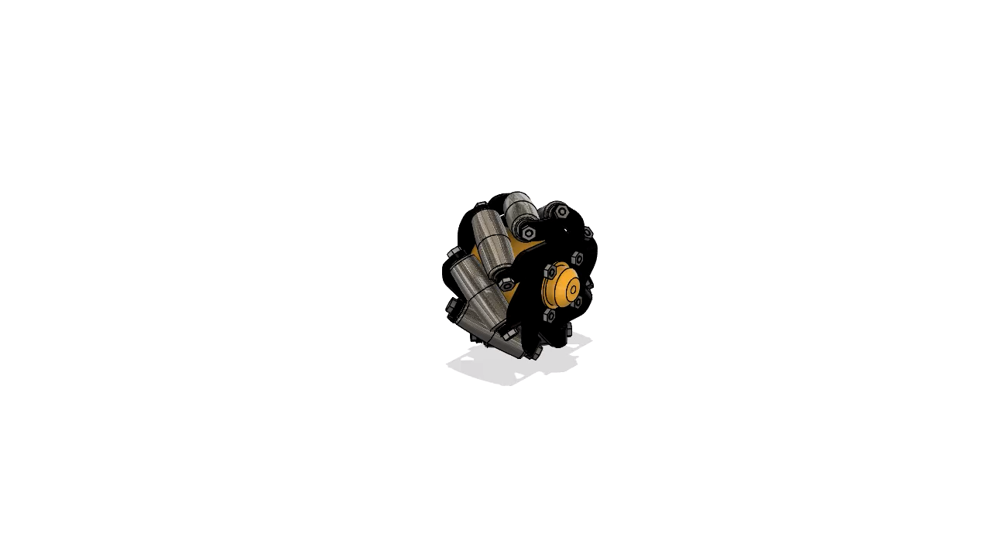
EXPLODED VIEW
(ANIMATION)
*All designs and simulations were done using FUSION360.
Notes:
For better visualization and understanding of assembly order, we have also included an exploded animation of our design. ------ This view illustrates all individual parts clearly, the hub, rollers, metallic frames and the fasteners.

Slide 10
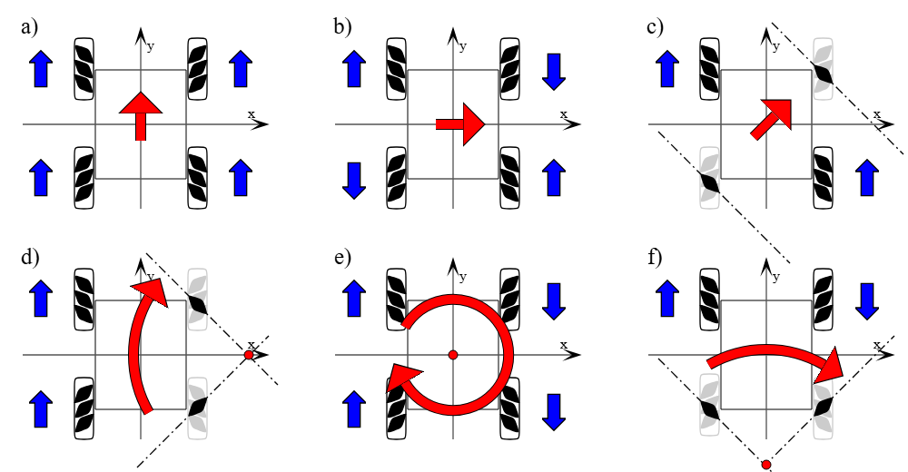
Movements to any directions:
blue: wheel drive direction
red: vehicle moving direction
a) Moving straight ahead
b) Moving sideways
c) Moving diagonally
d) Moving around a bend
e) Rotation
f) Rotation around the central point of one axle
Notes:
Mecanum wheels come in left-handed and right-handed variants based on the direction of roller tilt.
To ensure proper motion, each wheel's top roller must point toward the center of the robot. The diagonally opposite pair of wheels are left handed while the other set of wheels has the exact opposite orientation

Slide 11
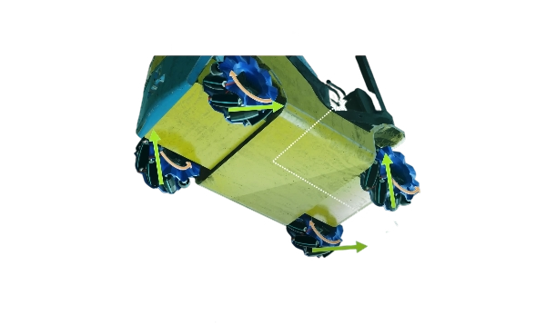
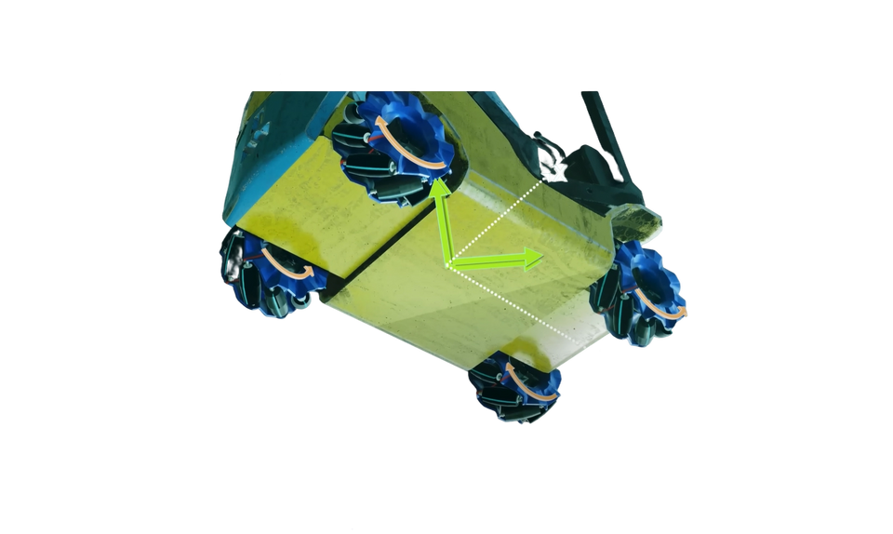
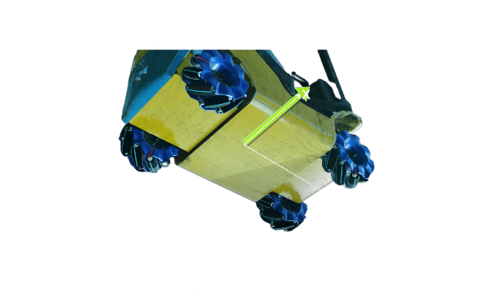
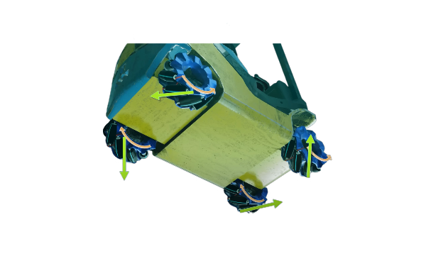
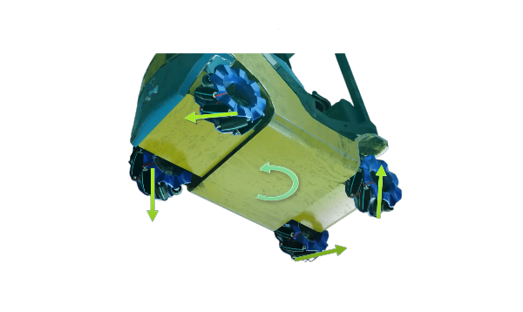
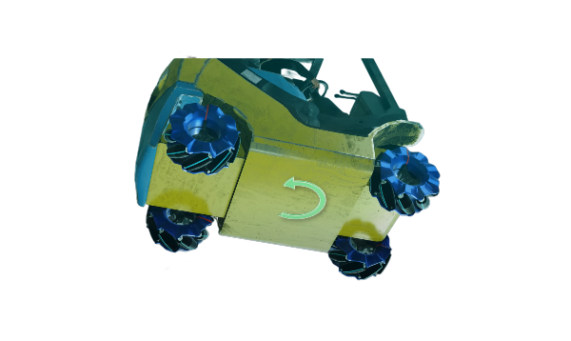
MOTION ANALYSIS
(1) Sideways (Strafing) Motion
→ Diagonal wheels rotate in opposite directions
→ Transverse forces add up, longitudinal forces cancel
→ Result: robot moves sideways
(2) Stationary Rotation
→ Left wheels rotate in one direction, right wheels in the opposite
→ Longitudinal forces cancel, transverse create torque
→ Result: robot spins in place
Notes:
Now let’s take a look at how Mecanum wheels enable unique movement patterns—something that’s simply not possible with conventional wheels.
Starting with sideways motion:To achieve this, we rotate the diagonally opposite wheels in the same direction, while the other pair rotates in the opposite direction.Friction force is generated at the point of contact.
If we break those forces down, you’ll see that the Y-components cancel each other out, while the X-components add up. The result? The vehicle glides smoothly sideways—something conventional wheels cannot do.
Now let’s explore pure rotation, where the vehicle spins in place around its center.To make this happen, we rotate the left-side wheels in one direction and the right-side wheels in the opposite direction. In this case, both the X and Y components of the forces cancel out completely.
There’s no translational movement—but the forces generate a net torque, which causes the vehicle to rotate perfectly in place.
This level of precise control is what makes Mecanum wheels so powerful—especially in environments where space is limited and high maneuverability is essential.

Slide 12
Movements to any directions:
blue: wheel drive direction
red: vehicle moving direction
a) Moving straight ahead
b) Moving sideways
c) Moving diagonally
d) Moving around a bend
e) Rotation
f) Rotation around the central point of one axle
Notes:
This shows how different configurations of wheel rotations will result in omnidirectional motion. The blue arrow shows direct of wheel rotation, while the red arrow shows the dirn in which the vehicle moves.

Slide 13
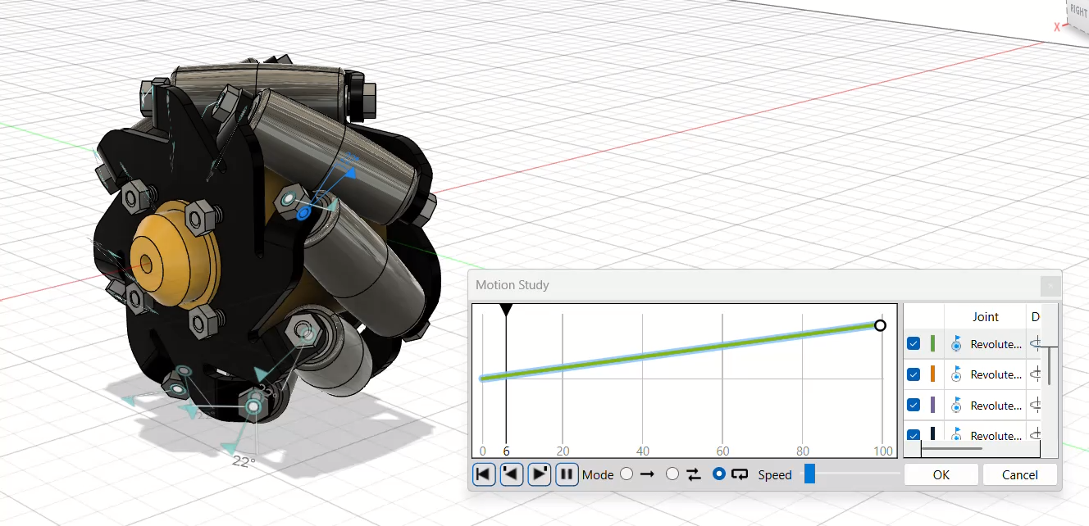
MOTION STUDY
*All designs and simulations were done using FUSION360.
Notes:
Here, we begin the motion study of the mecanum wheel. This animation basically simulates the motion induced by the motor when the wheel would ideally be in operation. You can closely observe the rollers mounted on the hub, each is rotating independently with the help of revolute joints placed about the respective axes.

Slide 14
WHY MECANUM WHEELS ROCK (AND WHEN THEY DON'T)
👍 Pros:
👎 Cons:
Compact: Easy to fit into tight designs.
High Load Capacity: Can carry serious weight.
Simple to Control: Makes omnidirectional motion feel like a game.
Low-Speed Precision: Great for controlled, careful movement.
Modular: Work well in robot chassis and mobile platforms.
Discontinuous Contact: Not always smooth rolling.
Tricky Terrains: Sensitive to bumps and uneven surfaces.
Complex Design: Angled rollers = more parts, more planning.
Low Pushing Power Diagonally: Not ideal for heavy-duty diagonal moves.
Notes:
In this slide, we have elaborated on

Slide 15
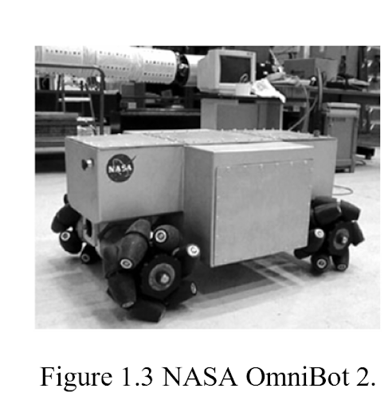
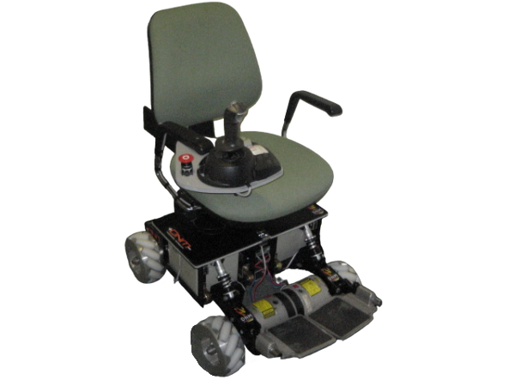
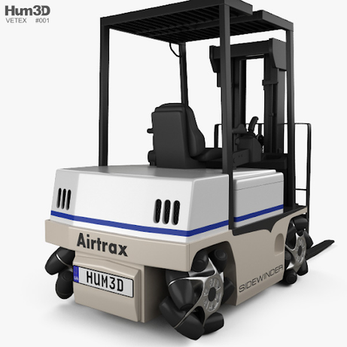
APPLICATIONS
Medical Field
Industrial Field
Military Field
.
Ideal for search‑and‑rescue missions, military operations, planetary exploration, and mine operations.
NASA uses Mecanum‑wheel robots to navigate hazardous environments.
OMNI Wheelchair (Office Wheelchair for High Maneuverability and Navigational Intelligence) is designed for individuals with severe mental and physical disabilities.
Controlled via a specialized joystick
Tight maneuvering and sideways transport of long loads through standard doors or narrow aisles.
Example: Airtrax ATX‑3000 forklift
Four 21×12" independently driven Mecanum wheels
Heavy‑duty hubs with 12 polyurethane rollers each

Slide 16

CONCLUSION
Mecanum wheels are used when omnidirectional movability of a vehicle is desired. That is, the vehicle can move along a prescribed path and at the same time rotate arbitrarily around its center. Usually, such environments are found in factory workshops, warehouses, hospitals, etc.
The Mecanum wheel, comprises of a set of rollers mounted at an angle around the hub.
The analysis focused on core kinematics of machinery concepts, including mobility analysis and velocity generation in different configurations.
Mechanism design emphasized roller geometry synthesis—approximated as a surface of revolution—and employed revolute joints to integrate rollers with the wheel frame.
The mecanum wheel-based platform, whose concept design is analysed, can be utilised in the future for multiple purposes as its final application.
Notes:
If the previous slides weren’t enough to convince you of the mechanical novelty and ingenuity of mecanum wheel, then I don’t know what will. In conclusion, we saw the roller geometry synthesis, and employed revolute joints to integrate rollers with the wheel frame. In the present day scenario, the use of mecanum wheels is limited to niche high tech industries due to complicated manufacturing procedure and high cost. However, in the coming future there is great scope for development and widespread utilisation of this design across varied sectors, if engineers are able to develope the necessary optimisation solutions. On this note, our presentation on this hell of an idea comes to an end. Hope you enjoyed, we thankyou for your time.

Slide 17

REFERENCES
Modeling and Adaptive Control of an Omni-Mecanum-Wheeled Robot
Kinematic Model of a Four Mecanum Wheeled Mobile Robot
Arduino Mecanum Wheels Robot - How To Mechatronics
IEEE Xplore Full-Text PDF:
A comprehensive study on Mecanum wheel-based mobility and suspension solutions for intelligent nursing wheelchairs | Scientific Reports
A Mecanum wheel model based on orthotropic friction with experimental validation - ScienceDirect
Practical applications for mobile robots based on Mecanum wheels - a systematic survey
https://youtu.be/noqBUEgyQ8A?si=ONjqrv54raVMs41W
Mecanum wheel - Wikipedia
https://www.sciencedirect.com/science/article/pii/S0167839608000770
SWOT
Analysis
Company Performance

